Slide 1
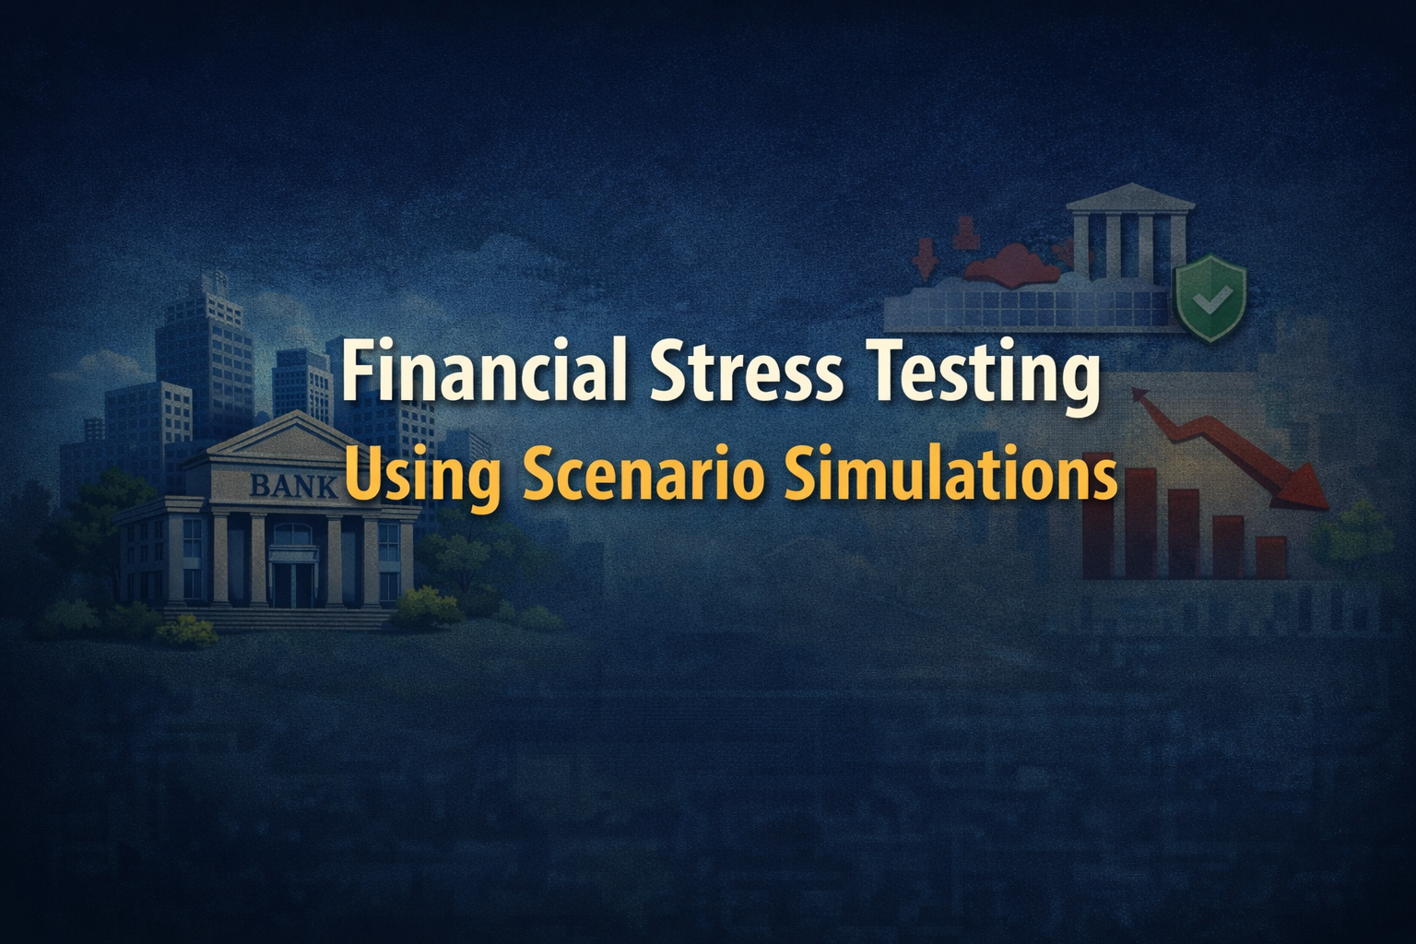
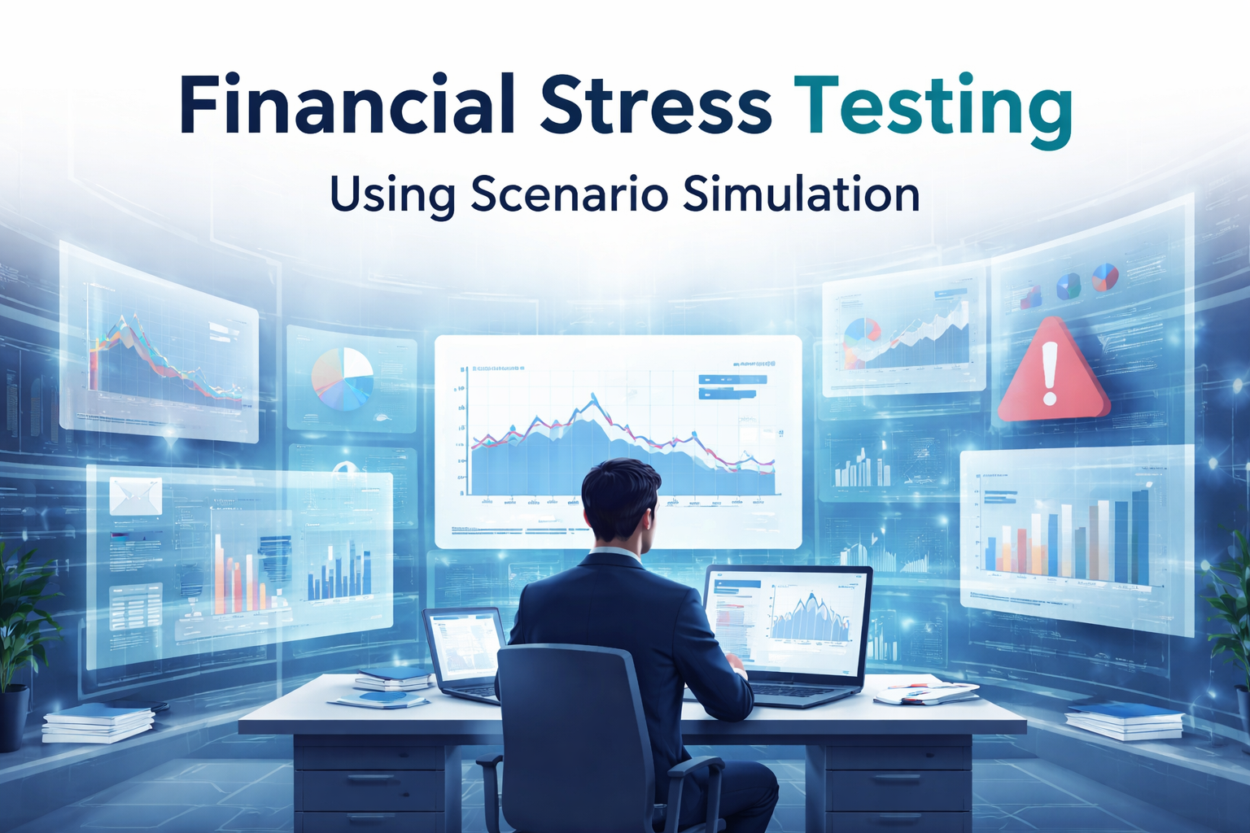

Slide 2
INTRODUCTION
Financial institutions operate in highly uncertain economic environments where sudden changes such as market crashes, interest rate fluctuations, inflation, and liquidity crises can significantly impact financial stability. Traditional risk assessment methods often fail to capture the impact of extreme but plausible economic conditions.
Financial stress testing is a powerful risk management technique used to evaluate the resilience of financial systems under adverse scenarios. By using scenario simulations, institutions can model hypothetical economic shocks and analyze their potential effects on assets, liabilities, and overall performance.
This approach helps organizations identify vulnerabilities in advance, improve preparedness, and support informed decision-making to ensure long-term financial stability.

Slide 3
PROBLEM STATEMENT
Financial institutions face increasing uncertainty due to economic volatility, market fluctuations, and unexpected financial crises. Traditional risk assessment models often rely on historical data and fail to accurately predict the impact of extreme economic conditions.
As a result, many organizations are inadequately prepared to handle severe stress events such as interest rate shocks, market crashes, or liquidity shortages. This lack of robust stress testing can lead to financial instability, unexpected losses, and poor risk management decisions.
Therefore, there is a critical need for an effective stress testing approach using scenario simulations to evaluate financial resilience under adverse but realistic economic conditions.

Slide 4
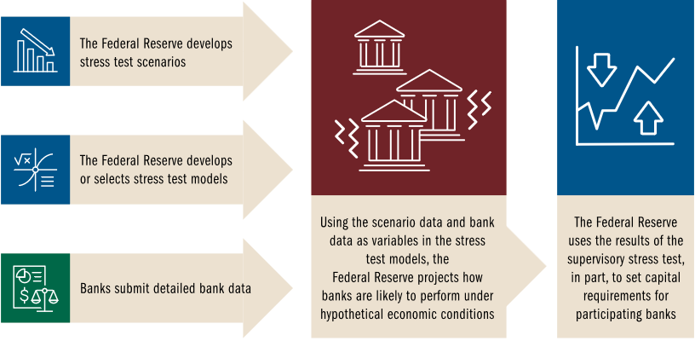
WHAT IS FINANCIAL STRESSING?
Financial Stress Testing is a risk management technique used to evaluate how a financial system, institution, or portfolio performs under extreme but plausible adverse economic conditions. It helps identify potential weaknesses and measure the impact of financial shocks before they occur in the real world.
Stress testing involves applying hypothetical stress scenarios—such as market crashes, interest rate hikes, inflation spikes, or liquidity shortages—to financial data to analyze their effects on profits, capital, liquidity, and overall stability.

Slide 5
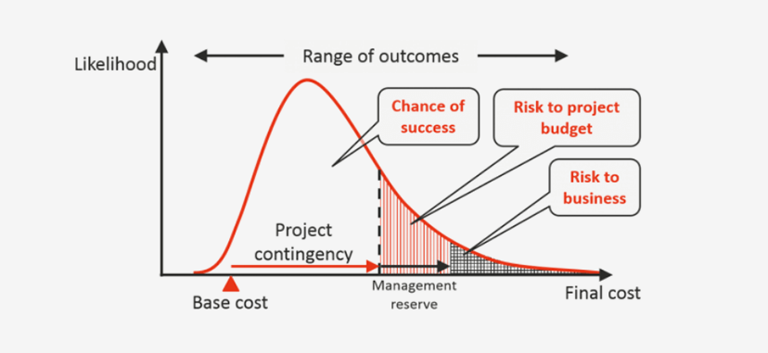
WHAT IS SCENARIO SIMULATI0N?
Scenario simulations are a technique used to model and analyze hypothetical but realistic future situations to understand how systems may behave under different conditions. In finance, they help evaluate the impact of economic shocks on financial performance, risk exposure, and stability.
These simulations apply assumed changes in key economic variables—such as interest rates, inflation, GDP growth, or market prices—to financial data. By observing the outcomes, institutions can anticipate potential losses, identify vulnerabilities, and prepare risk mitigation strategies.
Scenario simulations are essential in financial stress testing because they allow organizations to move beyond historical data and explore “what-if” situations, including extreme but plausible events.

Slide 6
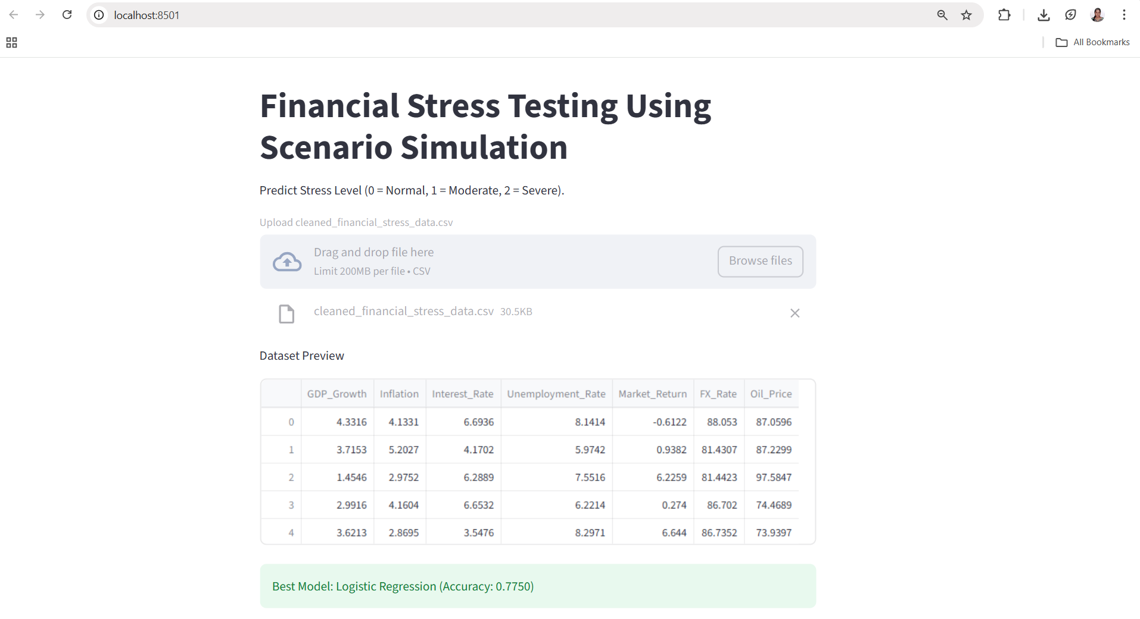
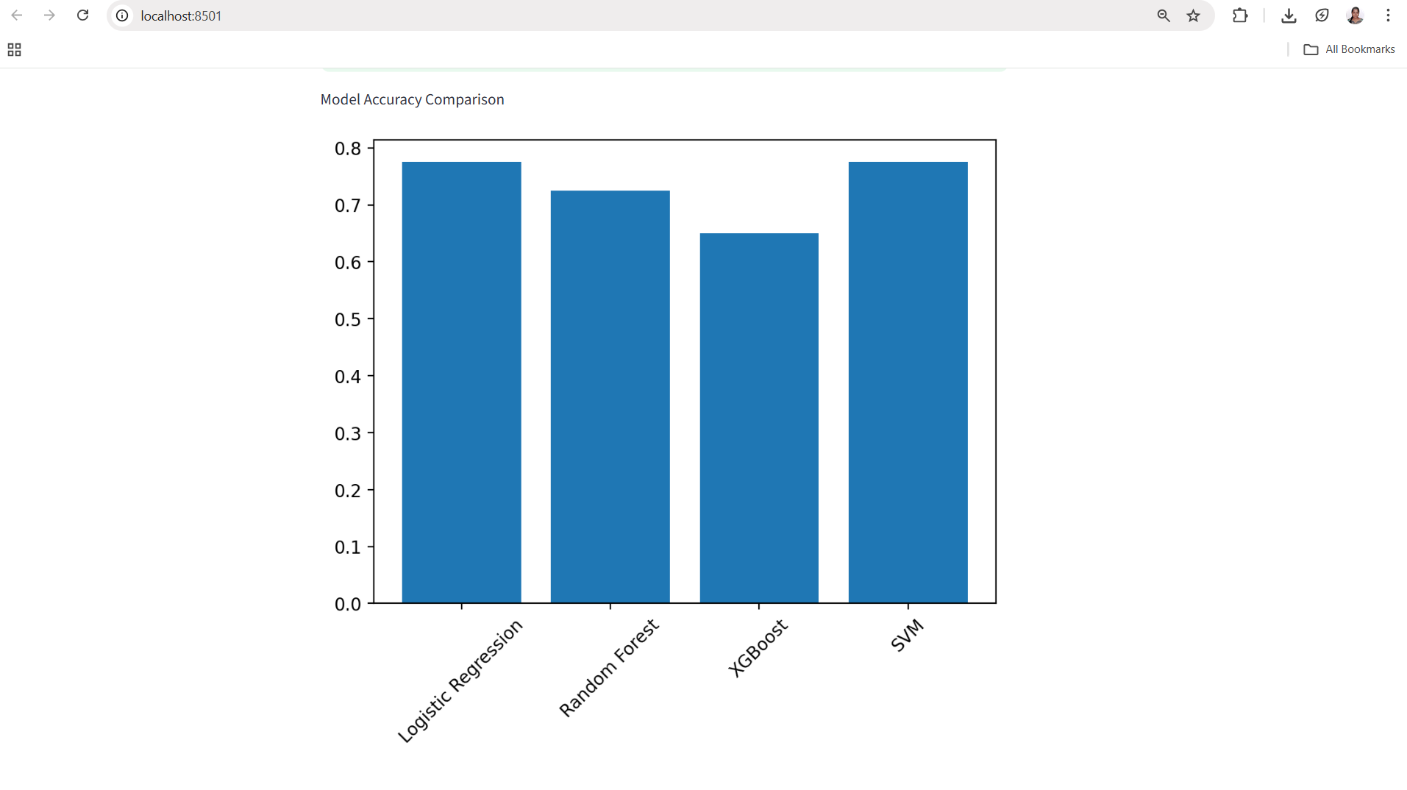
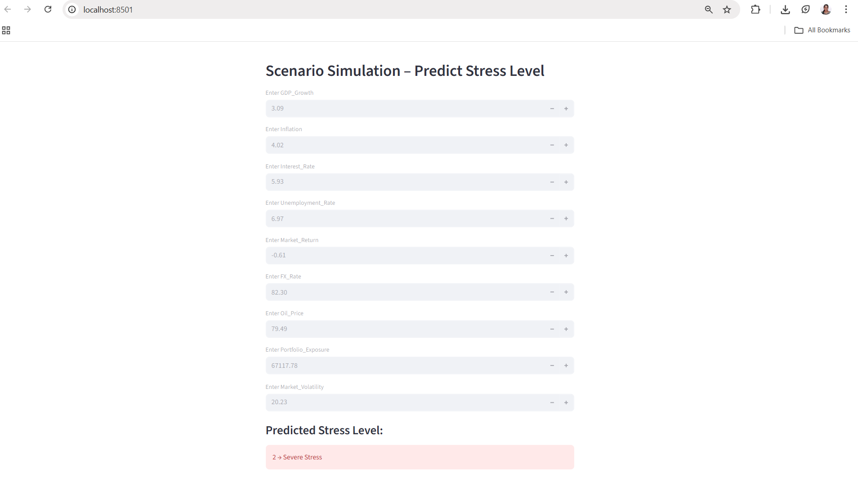
STREAMLIT OUTPUTS

Slide 7
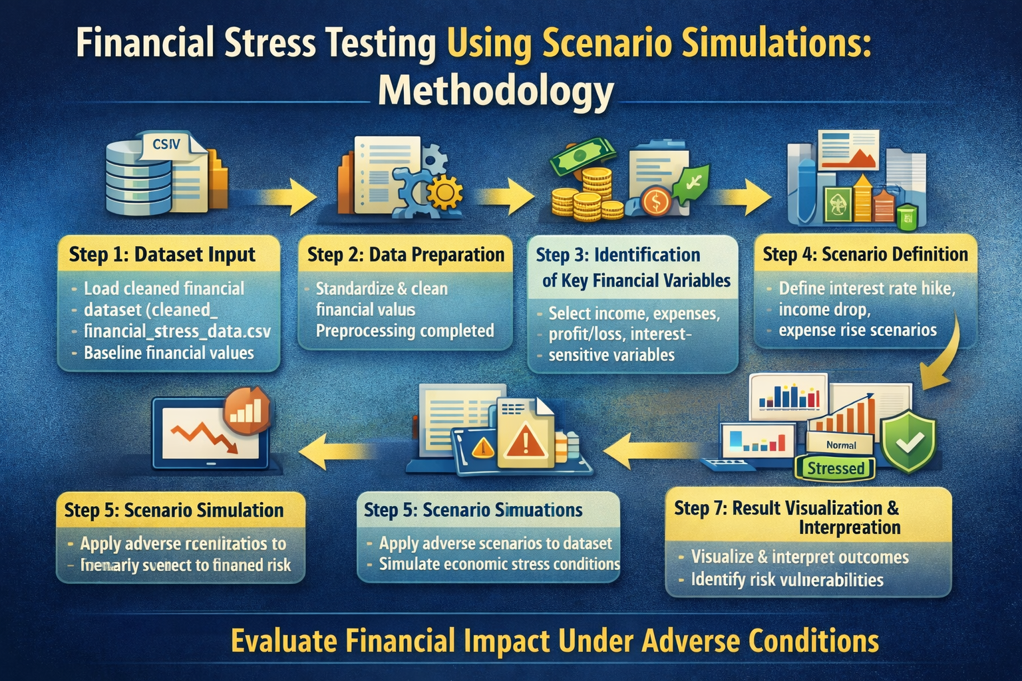
METHODOLOGY

Slide 8
TOOLS USED
PYTHON
PANDAS & NUMPY
STREAMLIT
VISUAL STUDIO CODE
JUPYTER NOTEBOOK
MATPLOTLIB & SEABORN

Slide 9
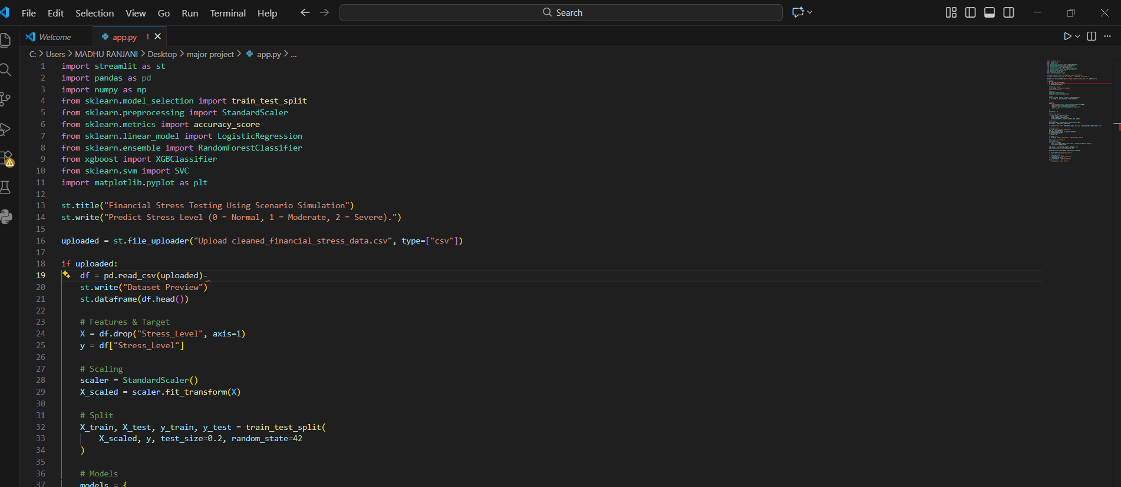
CODE
https://colab.research.google.com/drive/1kBfXGygY_V8be0JcLc_HsgyTP72GwkxA?usp=sharing

Slide 10
GITHUB
https://github.com/MadhuRanjani19/Financial-Stress-Testing-Using-Scenario-Simulations

Slide 11
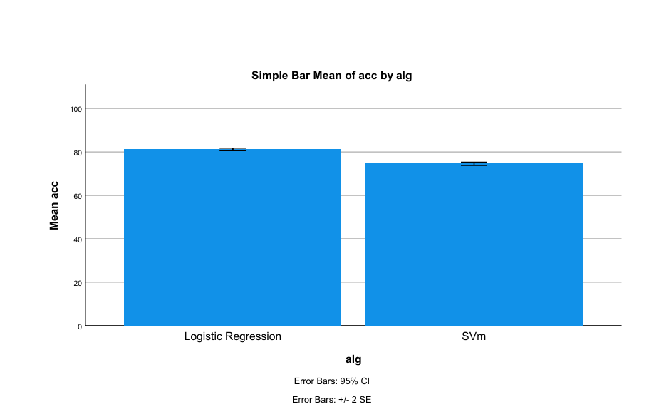
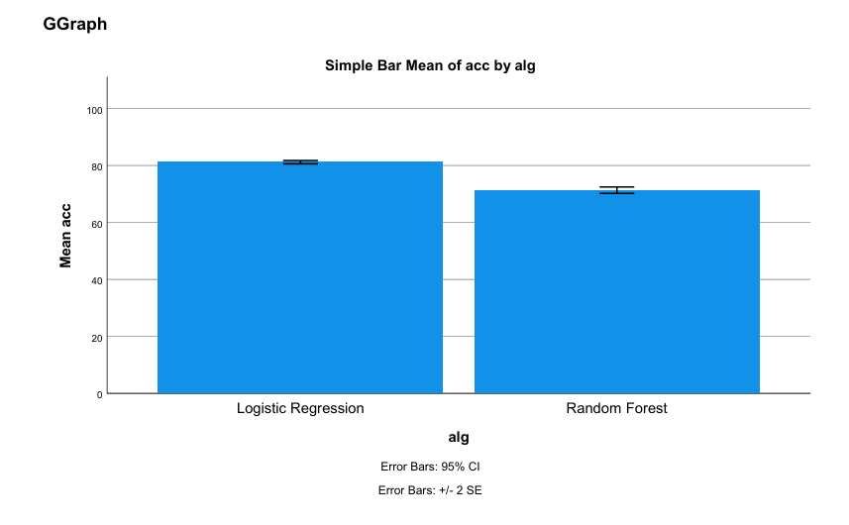
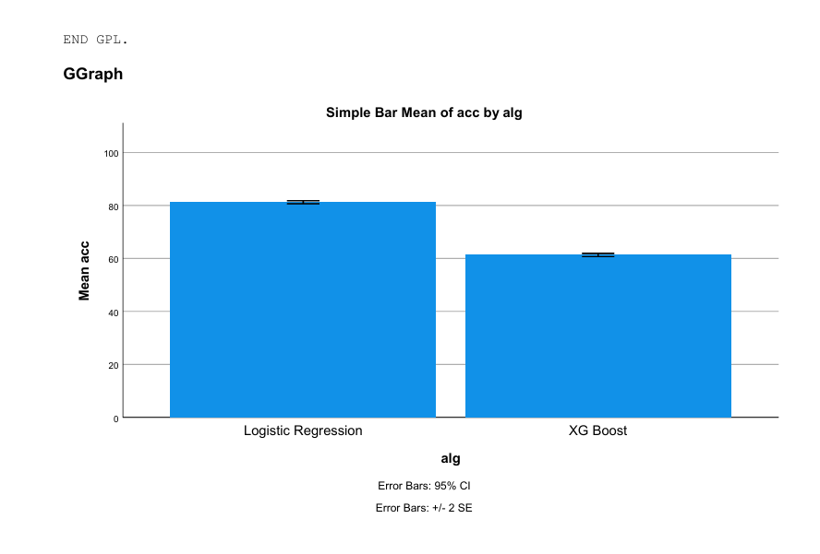
SPSS

Slide 12
RESULT & ANALYSIS
Under normal (baseline) conditions, the financial system shows stable performance with acceptable profit levels.
When stress scenarios such as interest rate hike, income reduction, and expense increase are applied, a significant decline in financial performance is observed.
Severe stress scenarios result in higher losses and increased risk exposure, highlighting vulnerable financial areas.

Slide 13
CONCLUSION
This project demonstrates the importance of financial stress testing in evaluating the resilience of financial systems under adverse economic conditions. By applying scenario simulations to financial data, the system effectively identifies potential risks, losses, and vulnerable areas that may arise during economic shocks such as interest rate hikes, income reductions, and market downturns.
The results highlight that severe stress scenarios significantly impact financial performance, emphasizing the need for proactive risk management. Overall, scenario-based stress testing supports informed decision-making, improves financial preparedness, and helps institutions maintain stability during uncertain economic environments.

Slide 14
thank you
S.MADHU RANJANI
DATA SCIENCE INTERN TRAINEE
maheshmadhu1971@gmail.com

